Slide 1
PowerPoint 4:
History of
bank note series
Lesson 4-1

Slide 2
1935 Series

Slide 3
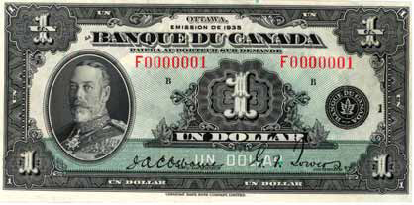
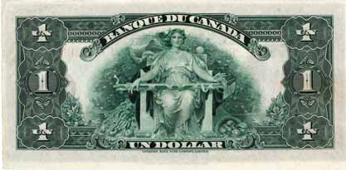
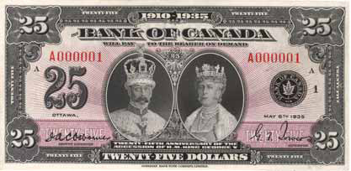
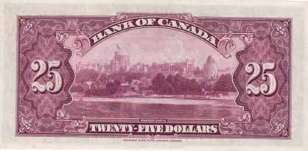
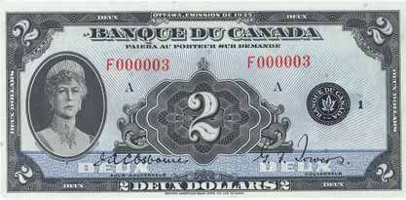
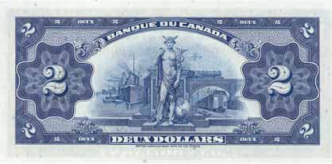
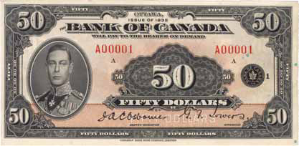
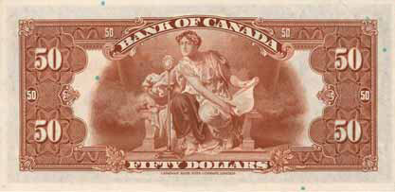
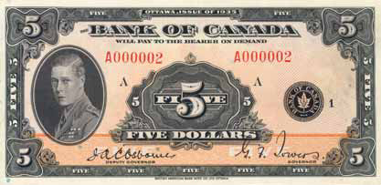
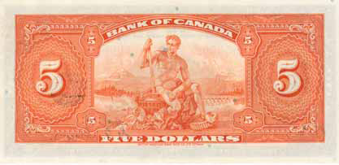
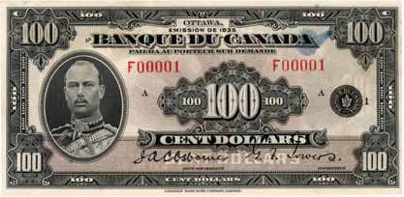
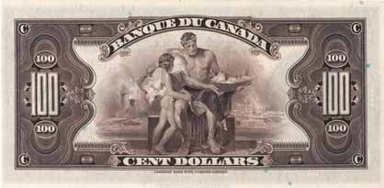
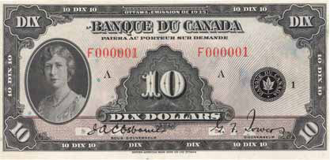
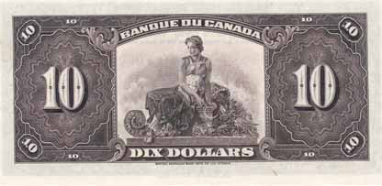
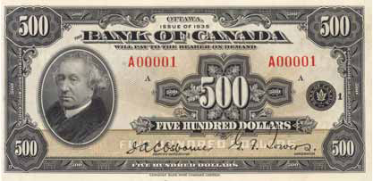
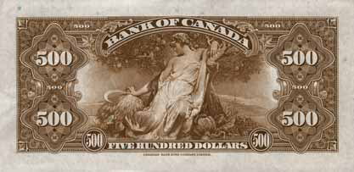
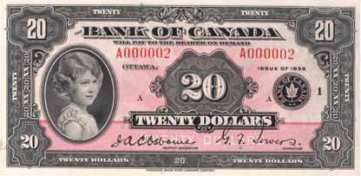
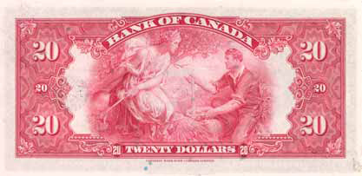
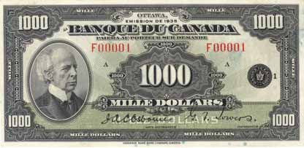
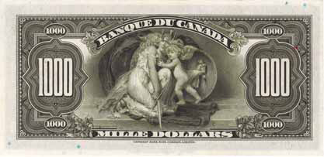
1935 series

Slide 4
1935 series: Security features
Raised ink
Fine-line detail
Planchettes (small, coloured discs scattered randomly in the paper)
4

Slide 5
1935 series: Themes
Front of the notes: featured members of the royal family or former prime ministers
Back of the notes: featured symbolic representations of Canada’s growing agricultural, industrial and commercial prosperity
5

Slide 6
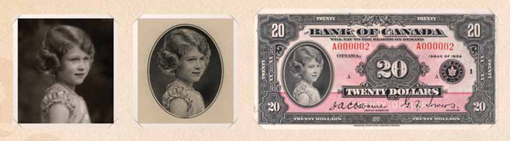
1935 series
Who is the little girl on the $20 note?
  Princess Elizabeth. She’s only eight years old in this
  portrait. She became Queen Elizabeth II in 1952.
Notes:
Queen Elizabeth II, circa 1934, Bank of Canada
Photograph by Marcus Adams

Slide 7
1935 series: Did you know?
This series was unilingual—notes were printed in either English or French.
This was the only series to have a $25 and a $500 note.

Slide 8
1937 Series

Slide 9
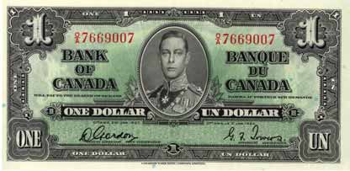
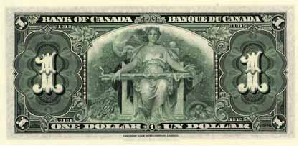
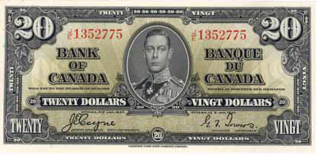
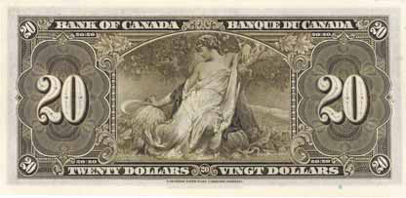
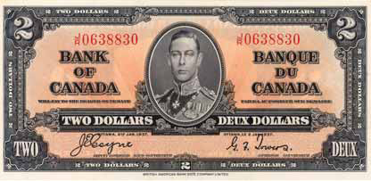
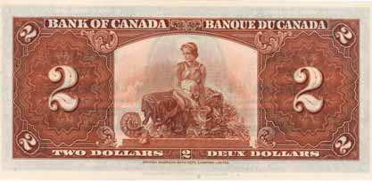
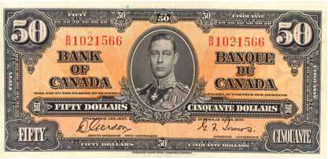
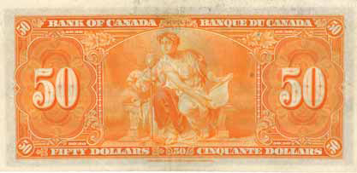
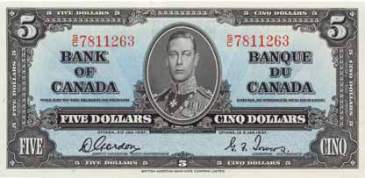
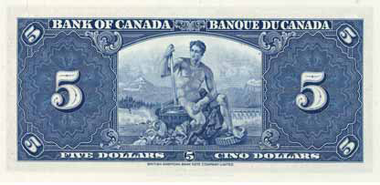
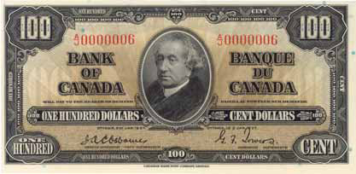
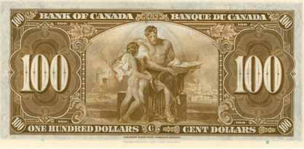
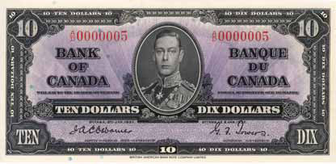
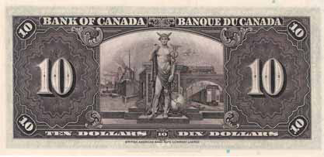
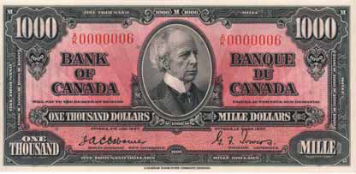
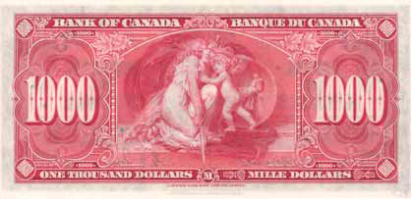
1937 series

Slide 10
1937 series: Security features
Raised ink
Fine-line detail
Planchettes

Slide 11
1937 series: Themes
Front of the notes: The portrait of the new king replaced those of other members of the royal family on all denominations (except the $100 and $1,000 notes, which featured former prime ministers).
Back of the notes: featured basically the same symbolic representations used on the
1935 series.

Slide 12
1937 series
Edward VIII was King of England from 20 January 1936 to 11 December 1936. Why is his image not on the 1937 series?
He proposed marriage to Wallis Simpson
(an American divorcee) and abdicated the throne
as a result.
Prince Albert, Edward’s brother, became King
George VI, and his image was used on the 1937
series. His life was depicted in the
movie The King’s Speech.

Slide 13
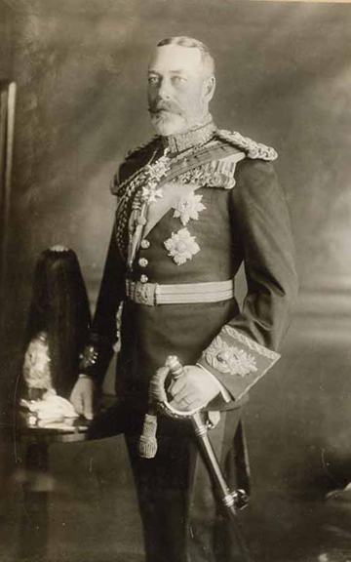
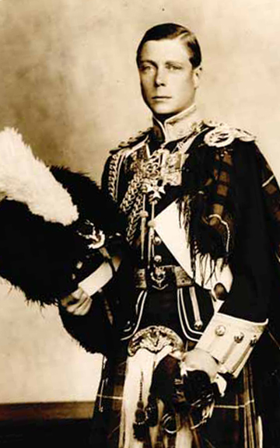
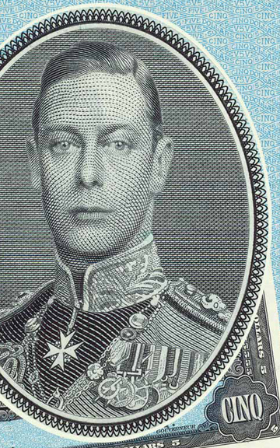
1937 series
George V (1935 series)
Edward VIII
(Prince of Wales on the 1935 series)
George VI
(Duke of York on the 1935 series, King of England on the 1937 series)

Slide 14
1937 series: Did you know?
This series was bilingual—notes were printed in both English and French.
The colours for each denomination in this series have been used in every subsequent series.

Slide 15
1954 Series
Canadian Landscape

Slide 16
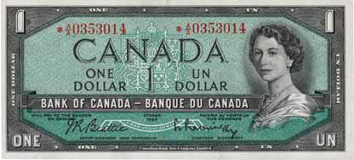
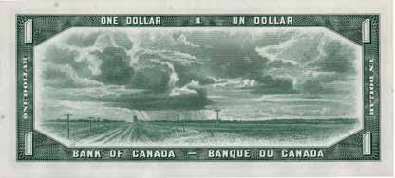
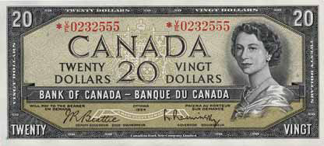
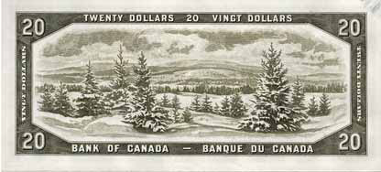
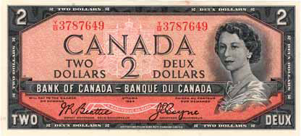
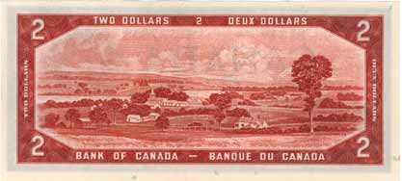
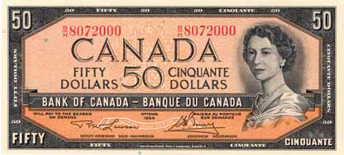
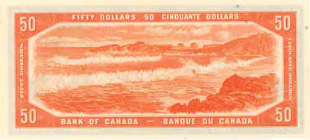
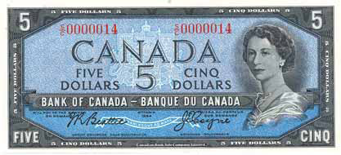
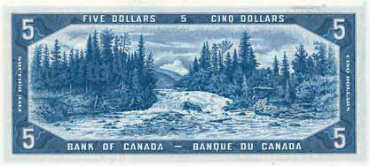






1954 series

Slide 17
1954 series: Security features
Raised ink
Fine-line detail
Planchettes

Slide 18
1954 series: Themes
Front of the notes:
  This is the only series to have the portrait of Queen Elizabeth II, the reigning monarch,
  on all notes.
  Canada’s coat of arms was introduced on these notes.
Back of the notes: Canadian landscapes

Slide 19
1954 series
What is this landscape?
  Saskatchewan prairie

Slide 20
1954 series
What is this landscape?
  Saint-François River from Upper Melbourne,
  Richmond, QC

Slide 21
1954 series
What is this landscape?
  Otter Falls, on the Aishihik River, YT

Slide 22
1954 series
What is this landscape?
  Emerald Lake and Mount Burgess, BC

Slide 23
1954 series
What is this landscape?
  The Laurentians, QC

Slide 24

1954 series: Did you know?
This series was printed after Queen Elizabeth II ascended the throne in 1952.
A likeness of a devil’s head seemed to appear in the waves of the Queen’s hair in this series.
The series was modified in 1956.
Notes:
Queen Elizabeth II, circa 1954, Bank of Canada
Photograph by Yousuf Karsh

Slide 25
1969–79 Series
Scenes of Canada

Slide 26














1969–79 series

Slide 27
1969–79 series: Security features
Raised ink
Fine-line detail
Planchettes

Slide 28
1969–79 series: Themes
Front of the notes:
  nicknamed the “multi-coloured series” because a variety of tints were used beneath the dominant colour
  portraits of former prime ministers were used to emphasize our national identity
Back of the notes: scenic vignettes

Slide 29
1969–79 series
What is this scene depicting?
  A tugboat in the middle of a broken log boom
  on the Ottawa River below
  Parliament Hill

Slide 30
1969–79 series
What is this scene depicting?
  An Inuit hunting scene at Pond Inlet on North
  Baffin Island

Slide 31
1969–79 series
What is this scene depicting?
  A salmon seiner in Johnstone Strait,
  northeast of Vancouver Island

Slide 32
1969–79 series
What is this scene depicting?
  Polymer Corporation in Sarnia, Ontario

Slide 33
1969–79 series
What is this scene depicting?
  Moraine Lake in Alberta’s Valley of the Ten Peaks

Slide 34
1969–79 series: Did you know?
Because of the low volume of $1,000 notes in circulation, this denomination was not included in the series.
This was the first series to:
  use the words “This note is legal tender”
  put the serial number on the backs of the notes
Notes:
Because of the low volume of $1,000 notes in circulation, this high-value note was not included in the series. The 1954 version continued to be distributed until 1992, when the Bank released a newly redesigned $1,000 note.

Slide 35
1986 Series
Birds of Canada

Slide 36














1986 series

Slide 37
1986 series: Security features
Optical security device—new for this series
Raised ink
Fine-line detail
Planchettes

Slide 38
1986 series: Themes
Front of the notes: new and larger portraits of the same prime ministers were used
Back of the notes:
  birds common to Canada became the focal point
  the colour of the birds matched the dominant colour of the notes (e.g., the osprey on the $10)

Slide 39
1986 series
Can you identify this bird?
  American robin

Slide 40
1986 series
Can you identify this bird?
  Belted kingfisher

Slide 41
1986 series
Can you identify this bird?
  Osprey

Slide 42
1986 series
Can you identify this bird?
  Common loon

Slide 43
1986 series: Did you know?
Withdrawn from the series:
  $1 note was not included
  in this series
  $2 note was withdrawn
  in 1996
  both were replaced with coins issued by the Royal Canadian Mint
This was the last series to use planchettes.

Slide 44
2001–06 series
Canadian Journey

Slide 45














2001–06 series

Slide 46
2001–06 series: Security features
Metallic stripe
Ghost image
Puzzle number
Dashes
Raised ink

Slide 47
2001–06 series: Themes
Front of the notes: new and larger portraits of the same prime ministers were used.
Back of the notes: celebrate Canadian history, culture and achievements (e.g., the $20 note celebrates Canadian arts and culture).

Slide 48


2001–06 series
Why are these texts significant to Canadians?
Notes:
“The Hockey Sweater” is a short story that was published in 1979 by Canadian author Roch Carrier. The story represents the significance and popularity of ice hockey as a Canadian pastime.
Canadian military doctor and artillery commander Major John McCrae wrote the poem “In Flanders Fields” while on the battlefield during the First World War. The poem has become a crucial part of Remembrance Day, which commemorates Canadians who died in service to Canada. Remembrance Day is held every November 11.

Slide 49

2001–06 series: Did you know?
This series introduced a tactile feature for the blind and partially sighted. It’s in the upper right corner on the front of each note.
The $5 and $10 notes were upgraded in 2006 and 2005, respectively, to include all of the same security features as the
$20, $50 and $100 notes.
Original
Upgraded

